Slide 1
The Attractions and Challenges for Overseas Investment in Latin America
By Jules “Jay” H. Marling, IV
MAI, CRE, FRICS, CEO & Managing Principal

Slide 2
About Capright
LARES 2017
FACTS
45 professionals, 10 offices
Headquartered in Chicago with offices in Dallas, Boston, Miami, Philadelphia, Tampa, San Diego, São Paulo (Brazil), San José (Costa Rica), México City
Specialize in providing valuation, consulting and due diligence services for institutional clients throughout the US and Latin America
ADVANTAGES
Independent and unbiased (i.e., not affiliated with a brokerage house or an accounting firm)
A team with the highest level of technical skills in the marketplace.
Consistent work product due to our centralized operating structure.
Proprietary data tools (transaction database, market surveys, custom financial models)

Slide 3
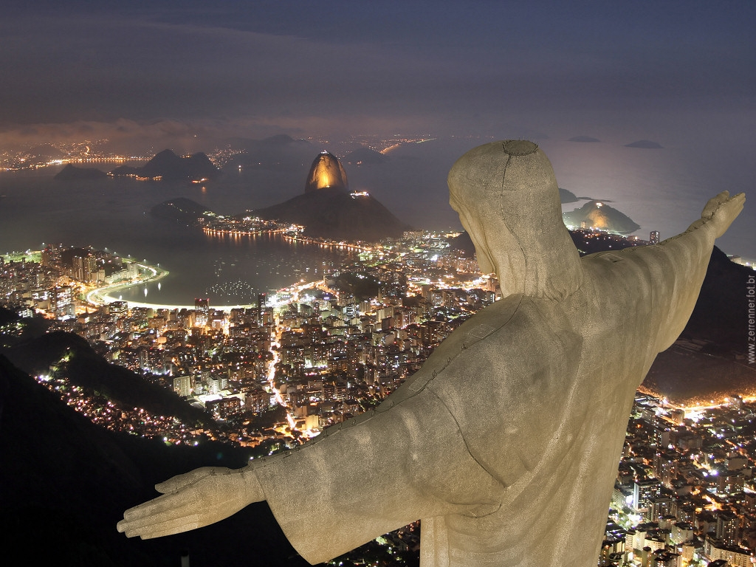
Advantage: All the ingredients for growth

Slide 4
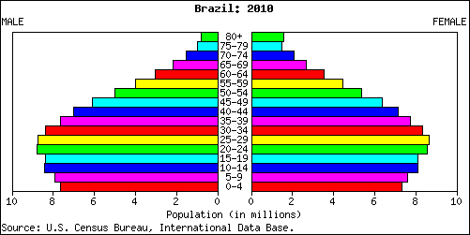
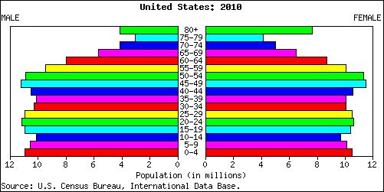
Advantage: Favorable Demographics
LARES 2017
POPULATION DISTRIBUTION
BRAZIL Young Population:
Tremendous growth potential
USA
Aging Population:
Limited growth potential

Slide 5
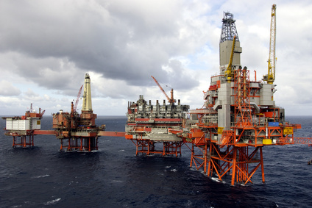
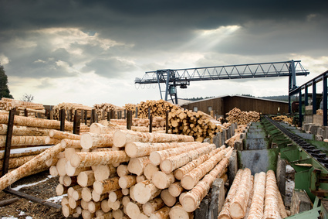
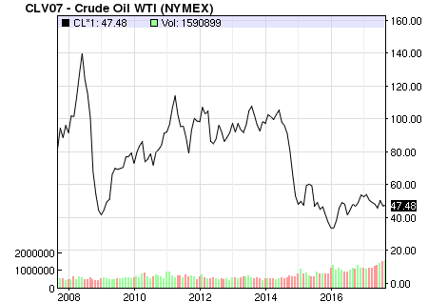
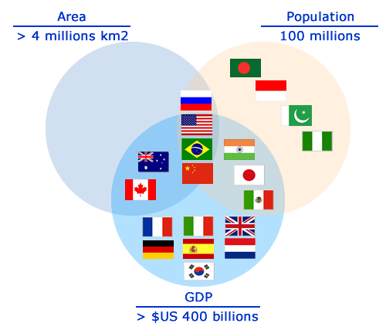
Advantage: Tremendous Abundance of Natural Resources
LARES 2017
Price of Oil
Brazilian Real / US Dollar

Slide 6
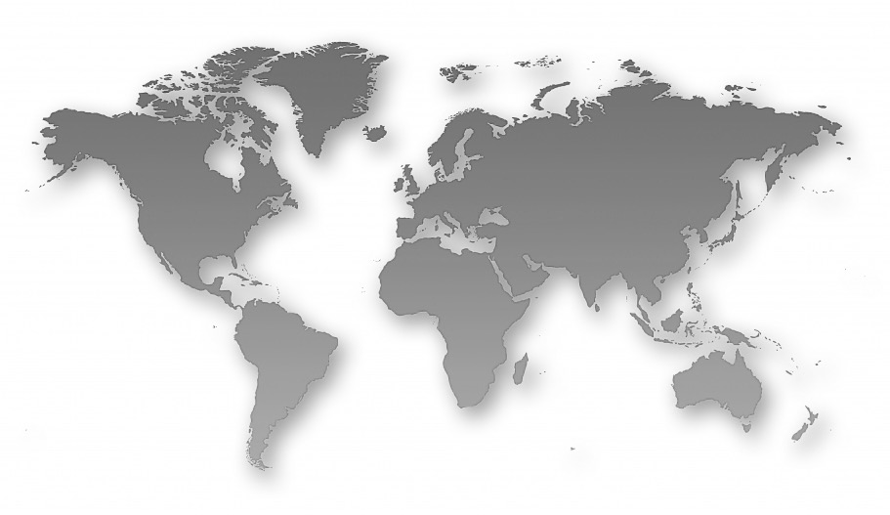
Advantage: Favorable Flight Times
LARES 2017
Route | Flight Time | TIME CHANGE |  | Route | Flight time | TIME CHaNge
Chicago to Beijing | 13 hours | 14 hours |  | Chicago to São Paulo | 11 hours | 2 - 4 hours
Chicago to Delhi | 22 hours | 12 hours |  | Chicago to México City | 5 hours | -----
Chicago to Moscow | 15 hours | 10 hours |  | Chicago to Bogotá | 6 hours | 1 hour

Slide 7
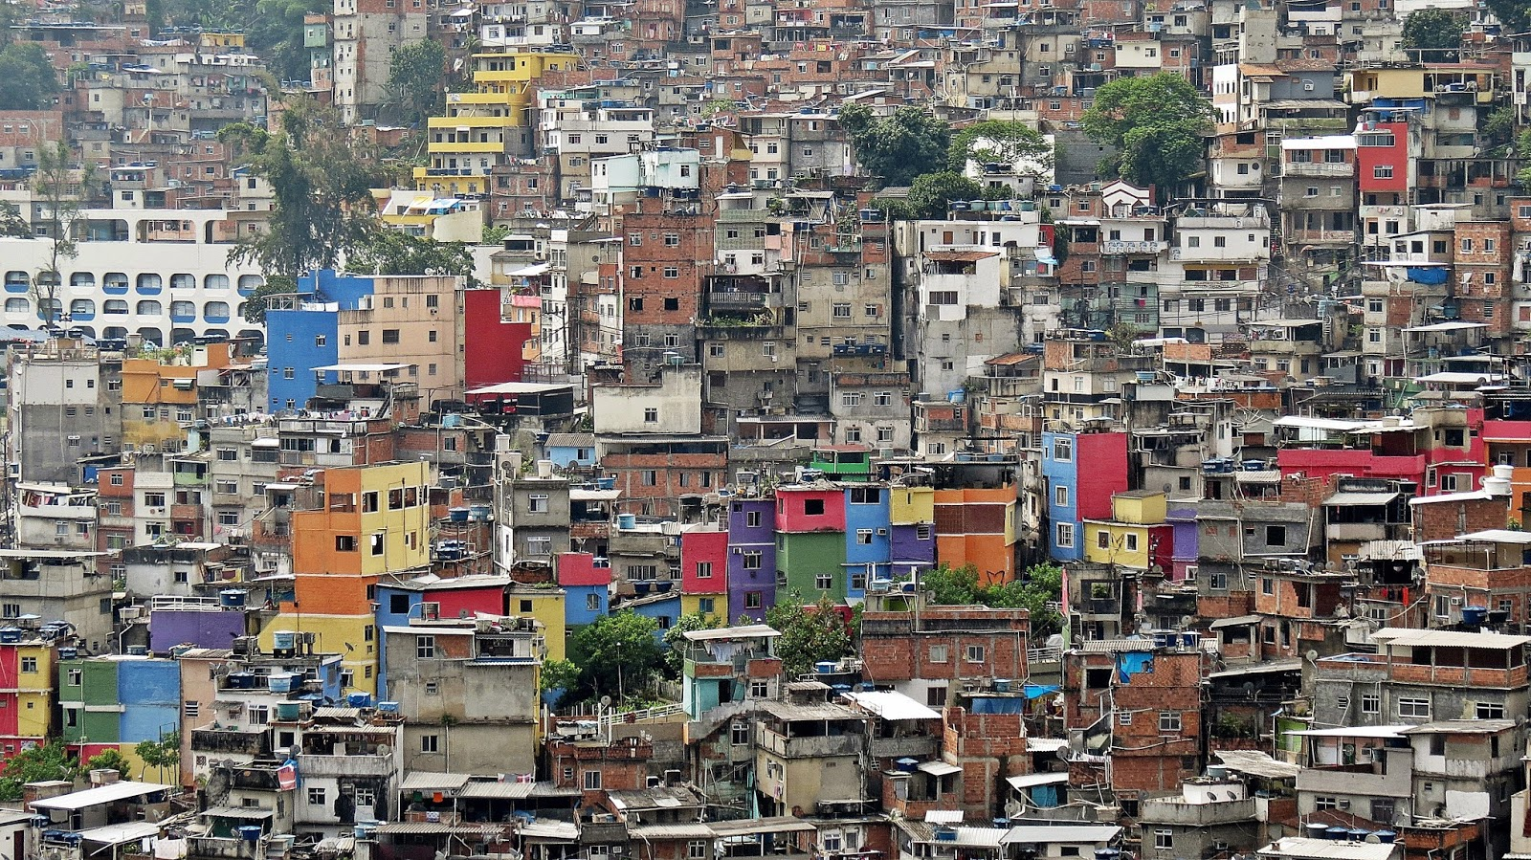
Disadvantage: Not Investing in the Future
Notes:
Note: Click on the “Picture Place Holder”, then send the picture back to get the black creamy effect.

Slide 8
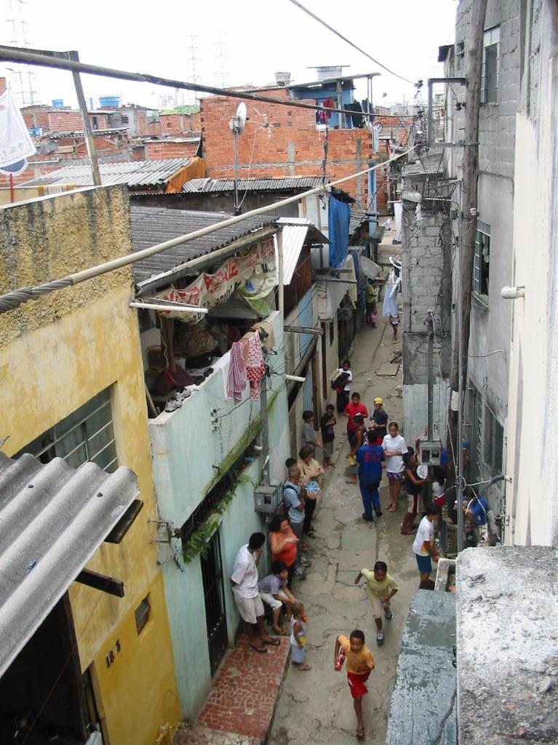
Disadvantage: Socio-Economic Issues
LARES 2017
In Brazil, 20 to 30 percent of the population lives below the poverty line.

Slide 9
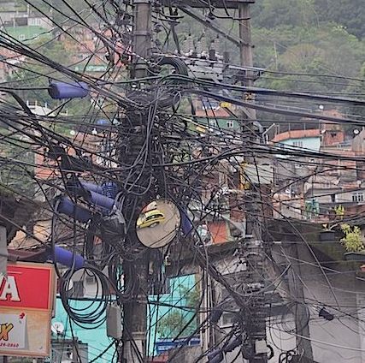
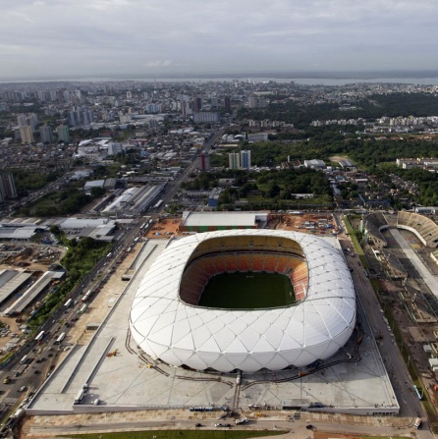
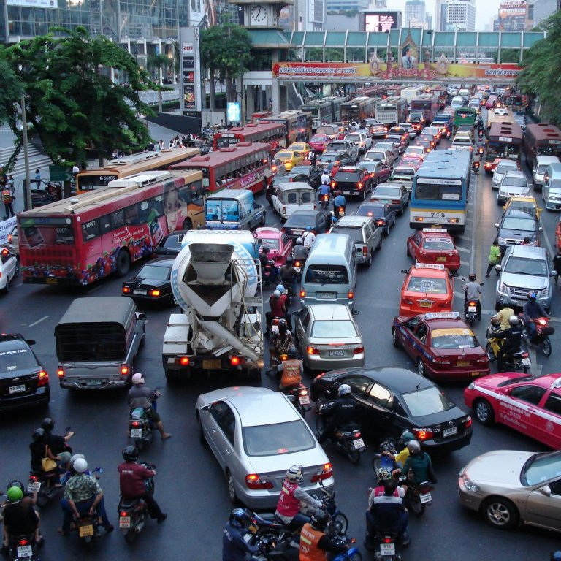
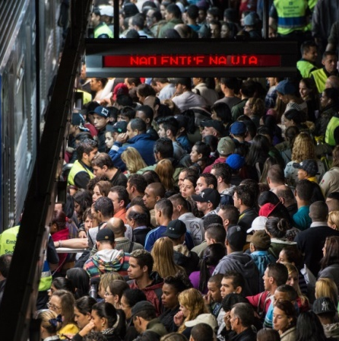
Disadvantage: Lack of Infrastructure
LARES 2017

Slide 10
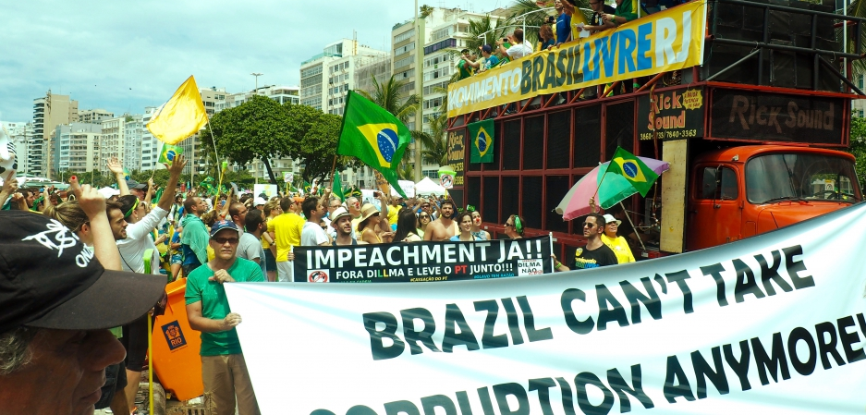
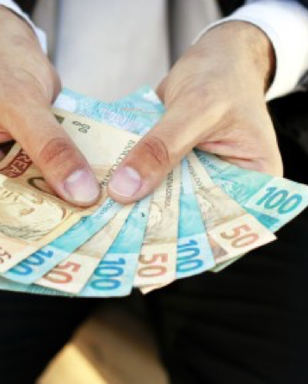
Disadvantage: Political Instability, Bureaucracy, Corruption
LARES 2017

Slide 11
Foreign investors are most concerned with understanding and quantifying the risks.
New emphasis on transparency and market analytics
To achieve superior risk-adjusted returns
Notes:
Note: Click on the “Picture Place Holder”, then send the picture back to get the black creamy effect.

Slide 12
Accurate,
Comprehensive
Market Intelligence
SiiLA is the leading data, analytics and networking platform for commercial real estate in Brazil.

Slide 13
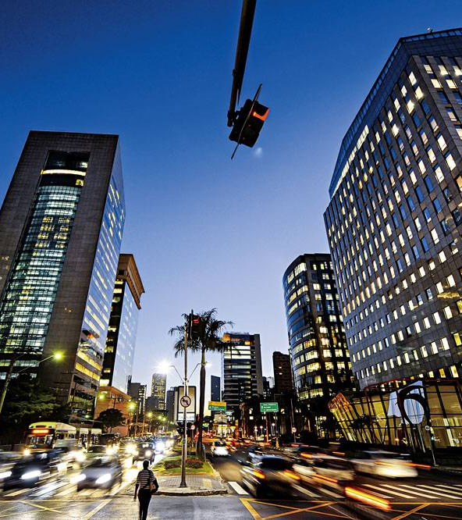
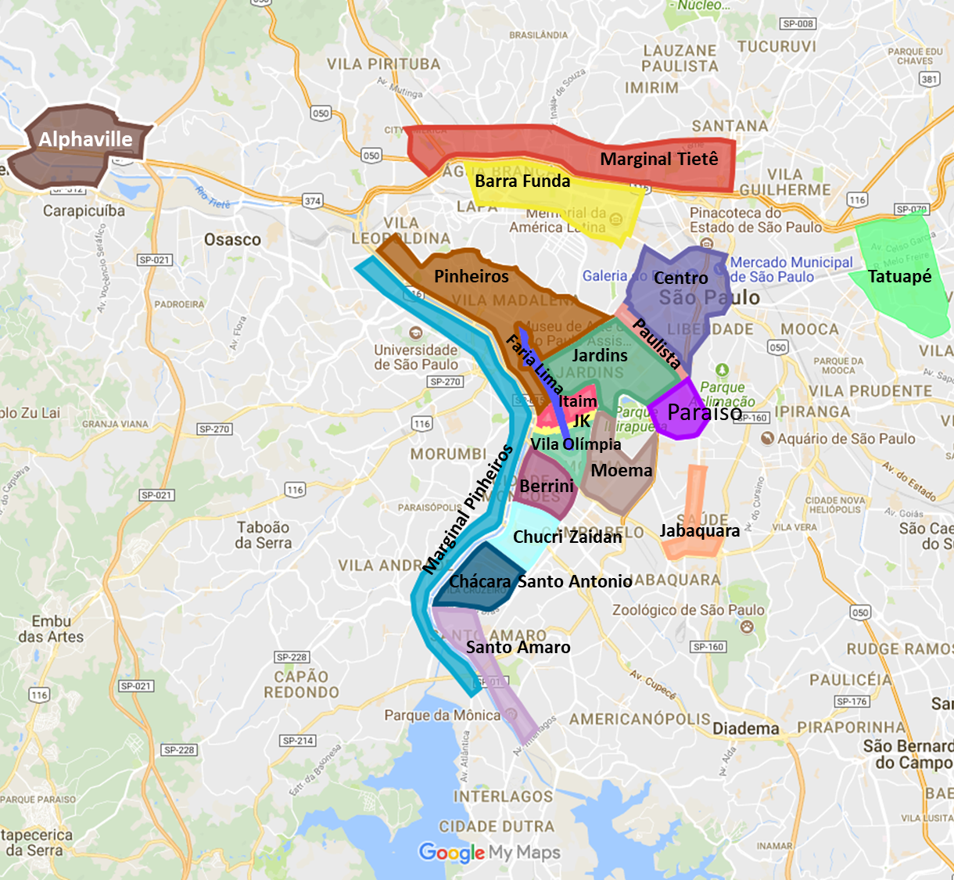
SÃO PAULO
OFFICE MARKET
159
A+ and A
260
B
11
CBD Regions
9
Non-CBD

Slide 14
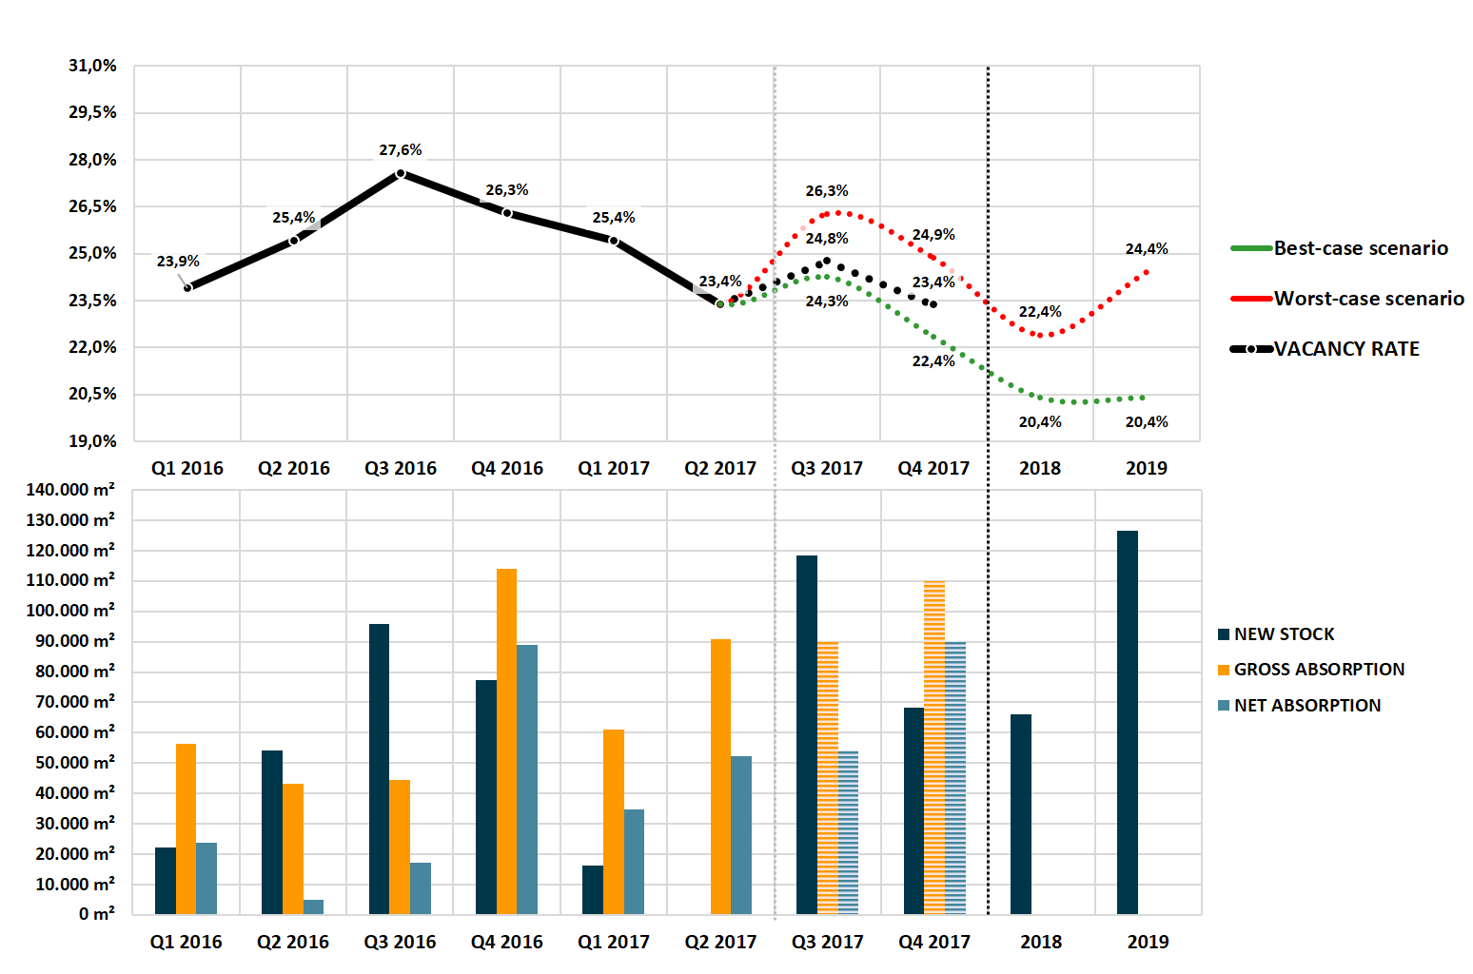
SÃO PAULO OFFICE MARKET ANALYSIS
A+ and A
São Paulo Office Market

Slide 15
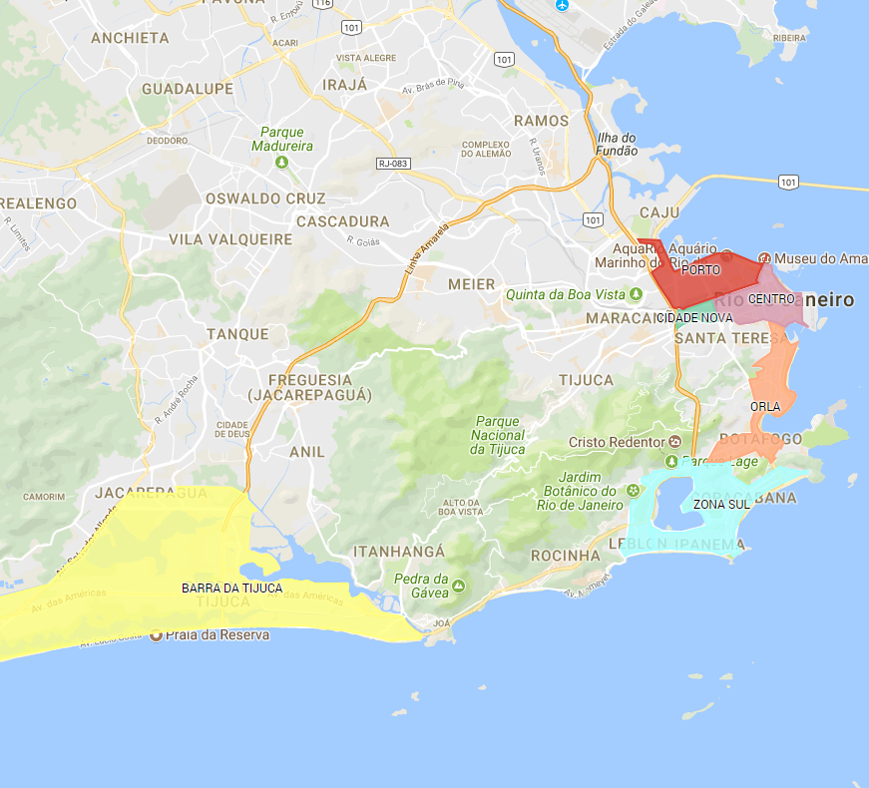
RIO DE JANEIRO OFFICE MARKET
99
A+ and A
141
B
6
Regions

Slide 16
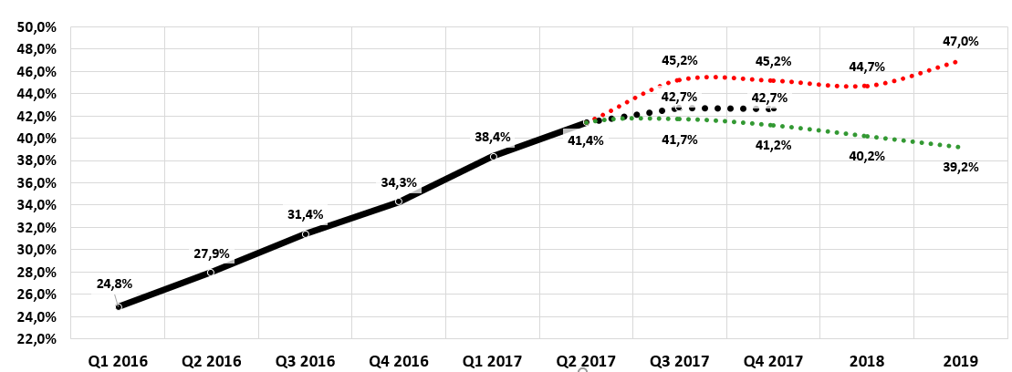
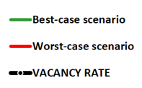
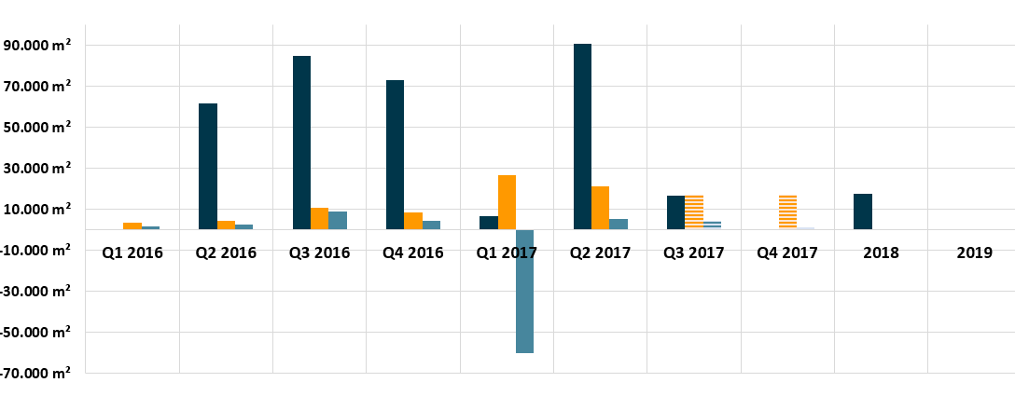
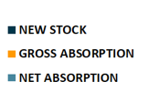
RIO DE JANEIRO OFFICE MARKET ANALYSIS
A+ and A
Rio de Janeiro Office Market

Slide 17
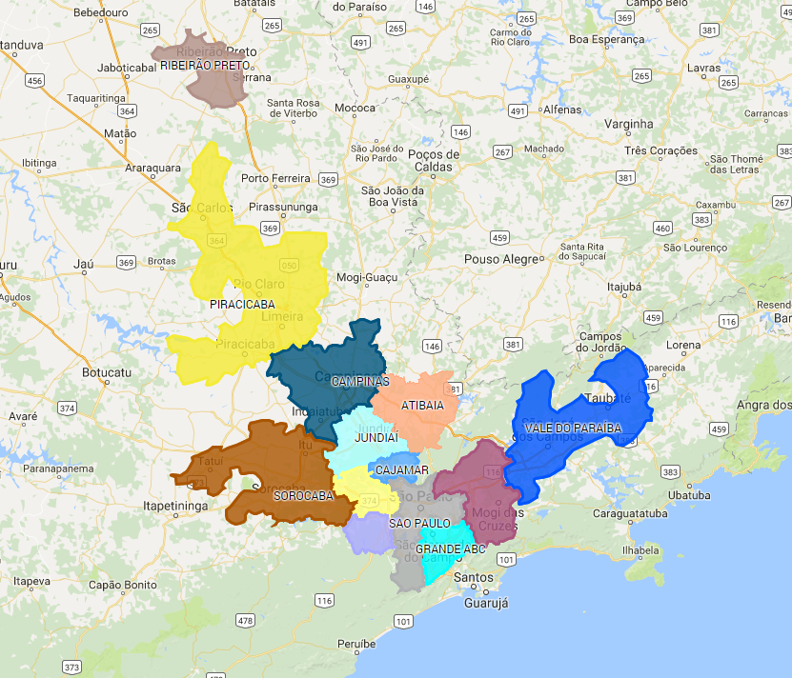
SÃO PAULO INDUSTRIAL MARKET
121
Warehouses
A+ e A
59
Warehouses B
13
Regions

Slide 18
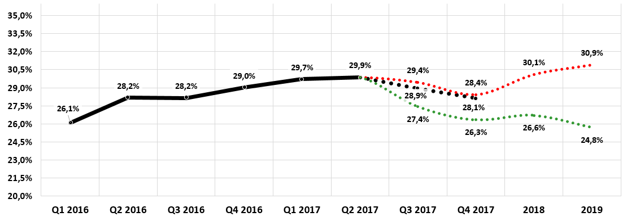
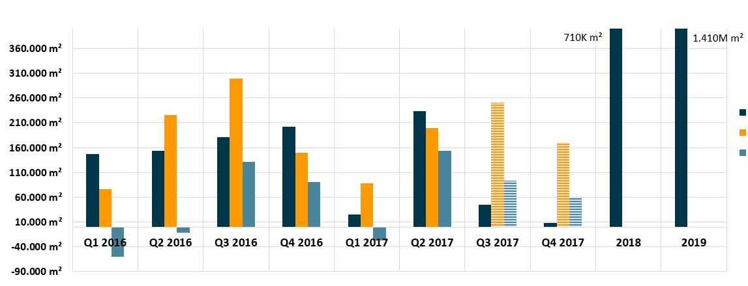
SÃO PAULO INDUSTRIAL MARKET ANALYSIS
A+ and A
São Paulo Industrial Market

Slide 19
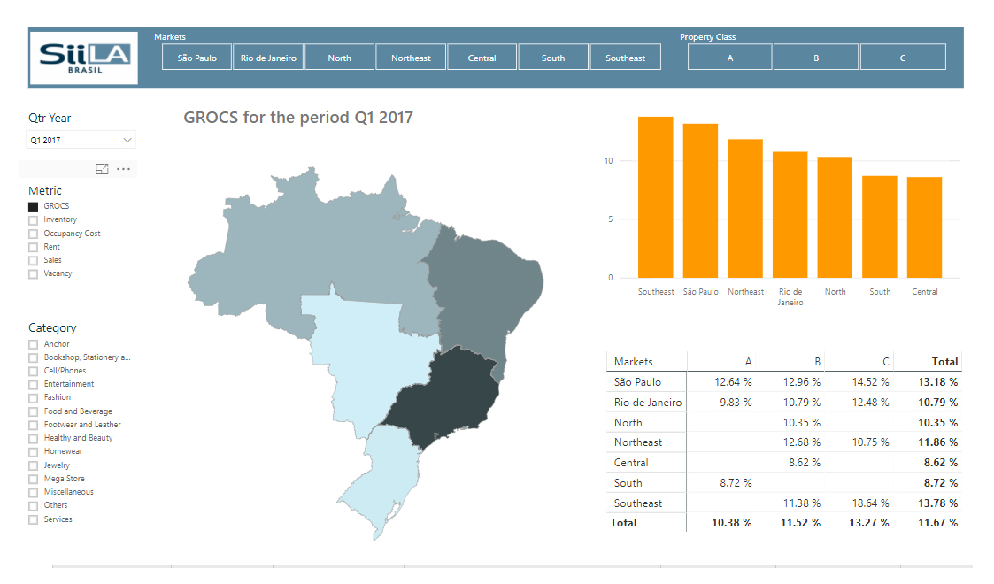
GROCS
Shopping Center Data & Analytics

Slide 20
CAP RATE
2016-2017
SÃO PAULO OFFICE (A+)
Average
10.20%
6.31%
8.28%
HIGHEST
SÃO PAULO INDUSTRIAL (A+)
Average
9.72%
8.14%
8.75%
HIGHEST
RETAIL (ALL BRAZIL)
Average
10.40%
5.30%
8.46%

Slide 21
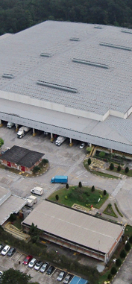
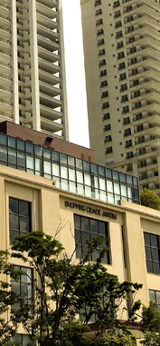
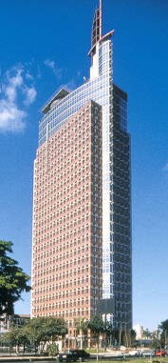
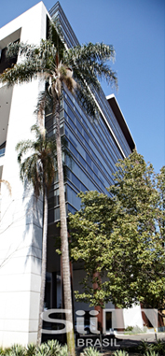
MAIN TRANSACTIONS
Pq. Da Cidade | Sucupira
Feb/17
Buyer: Fosun Sold Area: 32,504 m²
Price: R$ 432 million
Cap Rate: 6.49%
Fábrica e CD Nestlé - SBC
Feb/17
Buyer: GLP
Sold Area: 47,353 m²
Price: R$ 240,248,736
Cap Rate: 6.95%
Shopping Cidade Jardim
Oct/16
Buyer: Gazit Globe
Sold Area: 39,159 m²
Price: R$ 1,242,424,242
Cap Rate: 6.23%
Birmann 21
Jun/16
Buyer: GTIS
Sold Area: 1,383m²
Price: R$11,500,000
Cap Rate: 7.98%
Cidade Jardim
Jan/16
Buyer: Brookfield
Sold Area: 6,625,50 m²
Price: R$ 130 million
Cap Rate: 6.61%
Galpão Palmares
Jan/16
Buyer: Blackstone
Sold Area: 29,864 m²
Price: R$ 65,236,490
Cap Rate: 8.65%

Slide 22
The Rest of Latin America
LARES 2017

Slide 23
Jay Marling
jmarling@capright.com
OBRIGADO!
www.siila.com.br
contato@siila.com.br

